Slide 1

Sticky Shirt Sales
Brandon Gatto
Kennedy Nou
Vincent Li
Rounak Sengupta
Yash Gupta
Notes:
Vincent

Slide 2
Background
There is no efficient way to see yourself in clothes that you want to order online.
Some retailers allow customers to order their clothes and return them if they are unhappy with the purchase.
This is slow and inefficient.
There are stores such as Lenskart Glasses that allow you to upload a portrait of yourself in order to superimpose glasses frames onto your face.
This method is a step in the right direction but only allows the superimposition of one specific kind of clothing.
Notes:
(vincent)

Slide 3
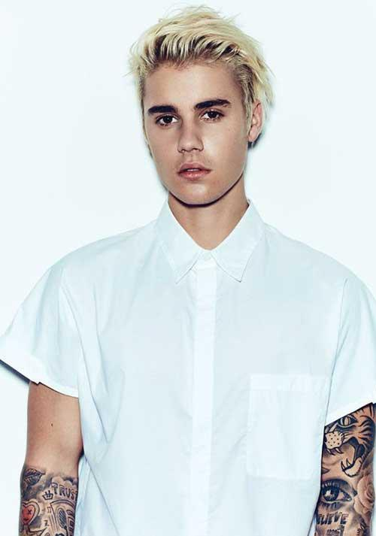
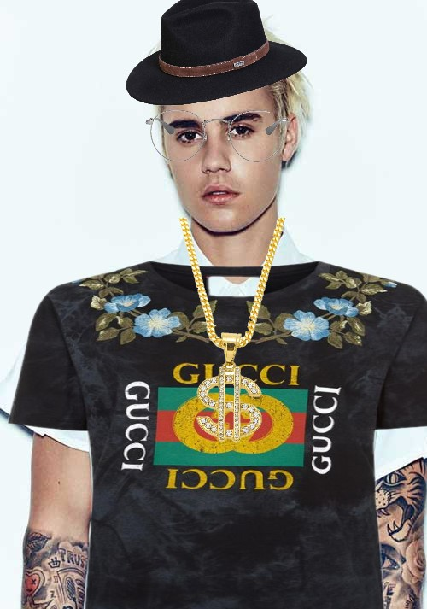
ProJect Purpose
Allow the users to upload photos of themselves in order to superimpose the clothing on the photos
They will also be able to create a 3D view of themselves from these pictures.
This will allow users to view themselves in the clothing before they choose to order the product.
Save the users time and reduce the number of returns made.
Notes:
(vincent)

Slide 4
Project Scope
Must Do
Customer can see themselves in clothes
Customer will have self-portrait collection
Compare different outfits
Should Do
3D View
Track customer purchase history
Website design
Could Do
Clothing Database
Won’t Do
Design clothing
Notes:
Vincent(vincent)

Slide 5
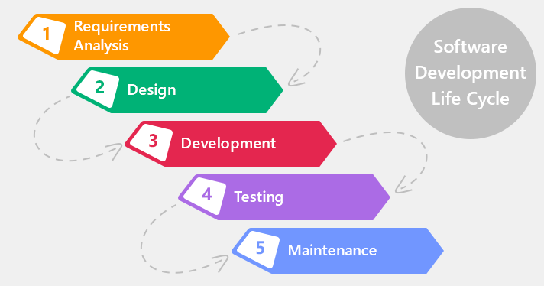
Presentation Sequence
Requirements gathering
Requirements modeling
Use cases
Database design
SQL script
System architecture
User interface
Plans moving forward
Notes:
(vincent)

Slide 6

Requirements Gathering
Interviews
with company’s owners, developer, and users
Survey
Gathered functional and nonfunctional requirements
Notes:
(vincent)

Slide 7
Functional Requirements
Functional
Informational:
Customers can upload their picture
Customers can enter in their dimensions to allow for a more natural superimposition and proper fitting
Process:
Customers can superimpose product on their picture
Customers can loop through sizes
Customers can search for clothing based on look or size
Customers can store multiple pictures

Slide 8
Non-Functional Requirements
Non-Functional
Operational:
Customers can view the product from multiple angles
Customers will see the exact fit of the clothes on themselves
Virtual clothing will represent the exact size and shape of clothing based on customer
Customers should be able to add items directly to their cart from the trying on tool
Performance:
Customers should easily be able to flip through different available styles
Customers changing clothing should be seamless
Customers will be able to select multiple items of clothing to try on at once
Customers should be able to try on each item from their selections individually or at once
Security:
Customers can share their look
Customers can maintain a “wardrobe” of clothing that they own to fit new accessories to the look
Cultural and Political:
System will allow customers of all races and political standings to be fitted with clothing
Customers will not receive any different treatment based on their uploaded photo

Slide 9
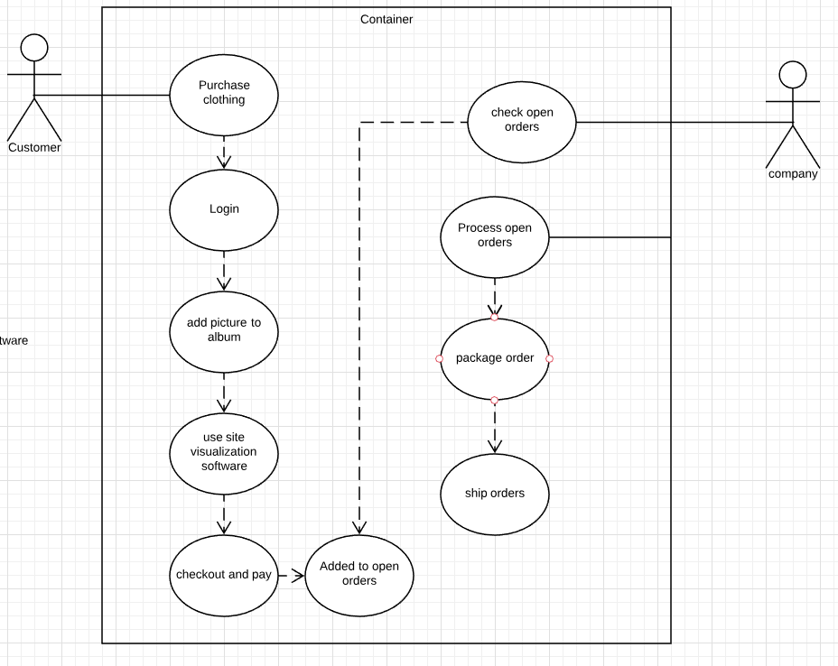
Business Use case
Customer will log in
Customer will add a picture to an album
Customer will select clothing
Customer will use site visualization software
Customer will check out and pay
Company will check open orders
Company will process the open order
Company will package order
Company will ship the order

Slide 10
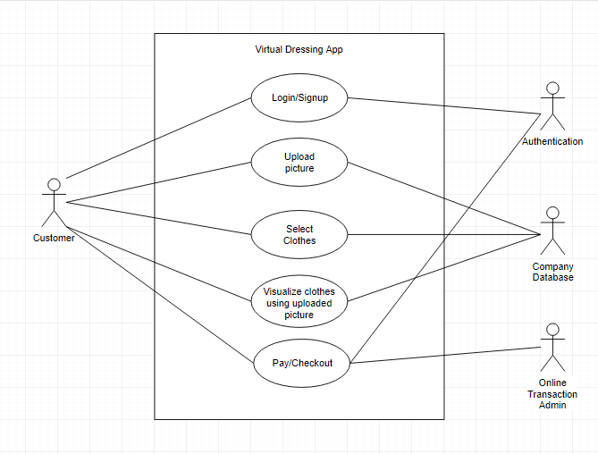
System Use Case
Login/Signup - Customer begins the usage when he logins or signups in the application. This is handled by authentication.
Upload Picture - Customer uploads his picture to visualize the clothes on. This picture is saved in the company database.
Select Clothes - Customer chooses from the clothing options available in the company database.
Visualize clothes using the uploaded picture - The application visualizes the customer in the clothes in the 3D view. In this use case, the selected clothes and picture of the customer are available from the company database.
Pay/Checkout - Customer buys the clothes after making a payment which involves an online transaction administrator and authentication.

Slide 11
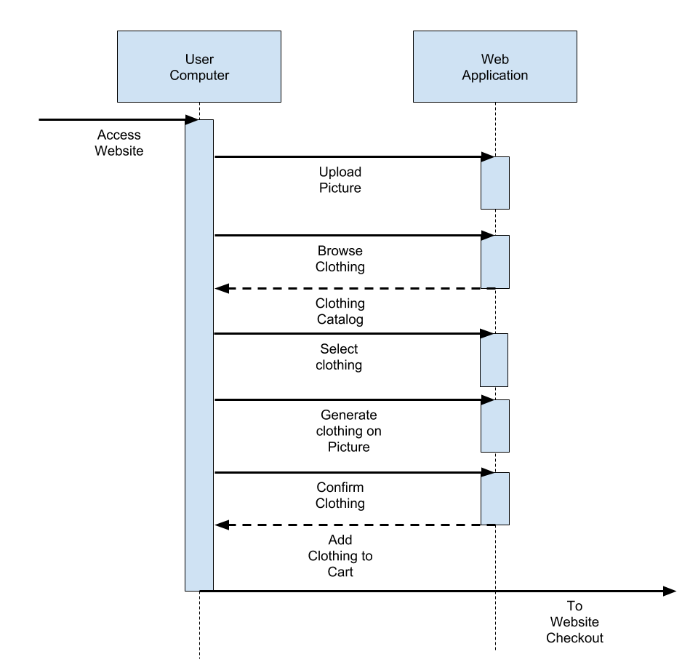
Behavioral Model

Slide 12
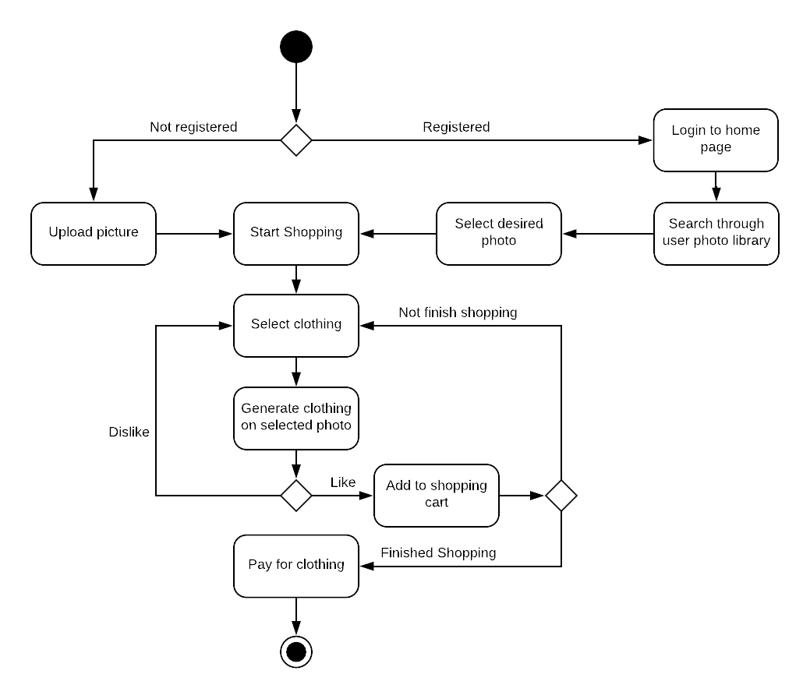
High Level Activity diagram
Notes:
YASH

Slide 13
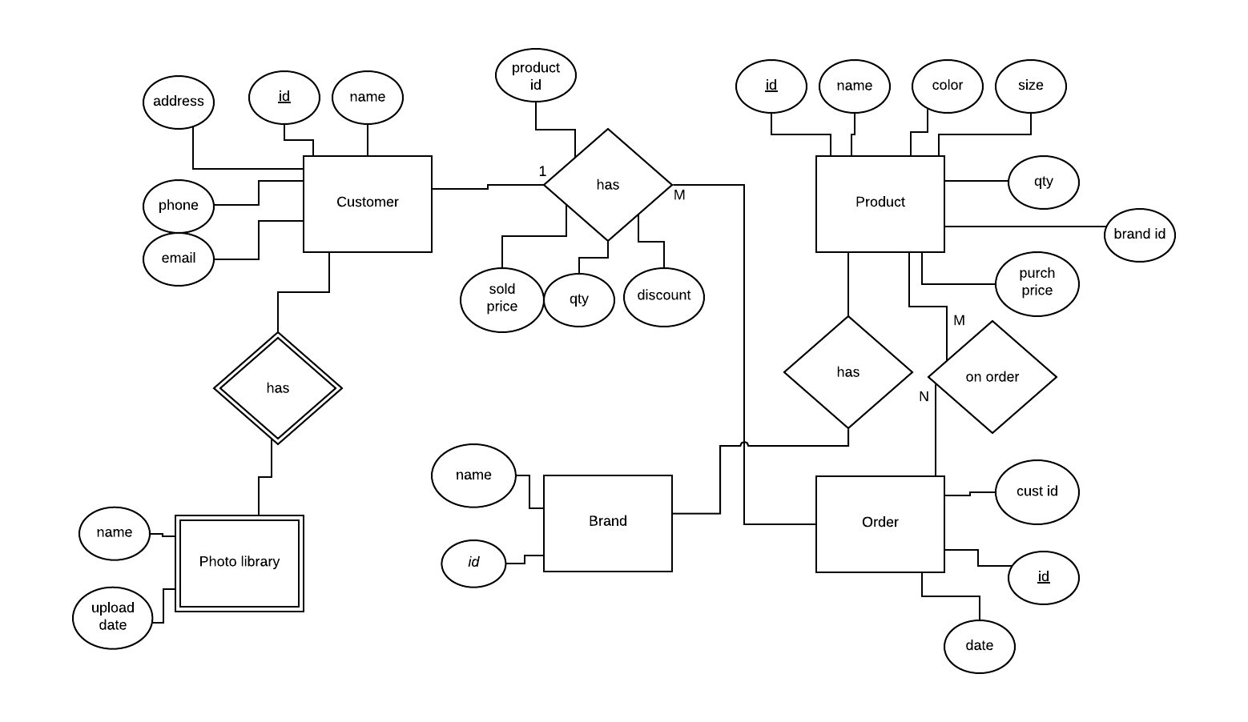
Conceptual Diagram (ER schema)
Notes:
YASH

Slide 14
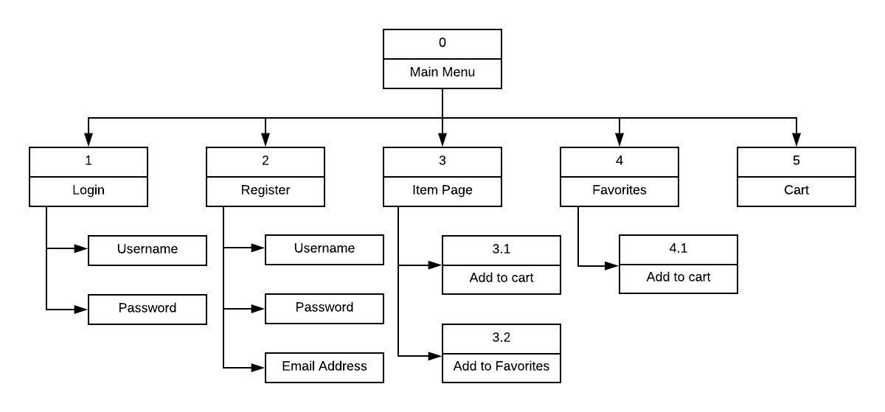
Interface Structure Design
Notes:
YASH

Slide 15
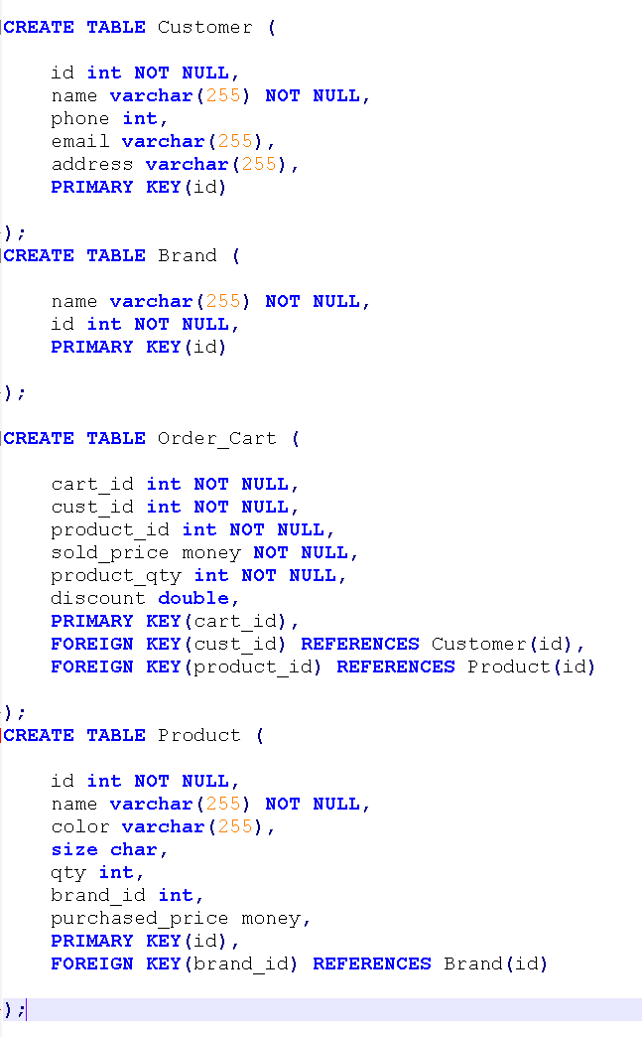
SQL Scripting

Slide 16
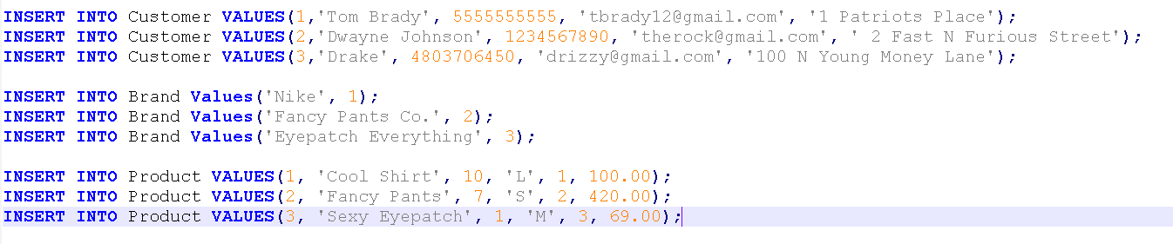
SQL Scripting

Slide 17
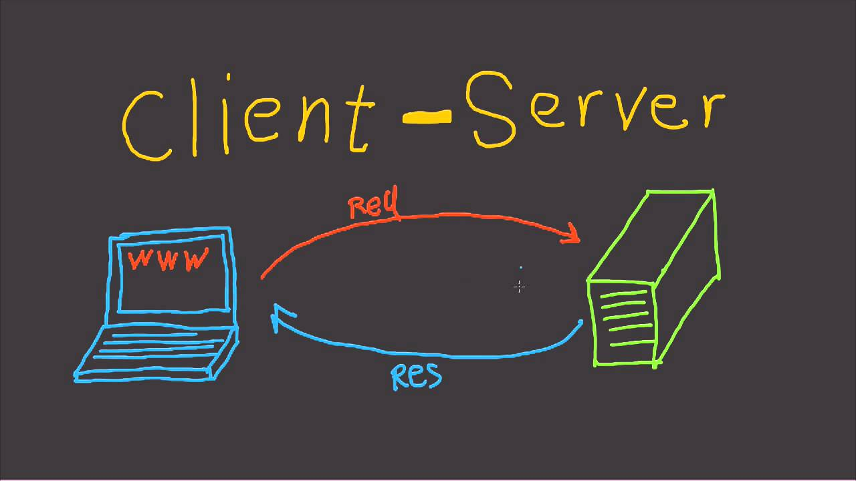
System Architecture
Ours is the 3-tier client server architecture
We do not need shared resources thus not using cloud architecture
We did not use 2-tier architecture because we require to validate data that we expect from the user

Slide 18
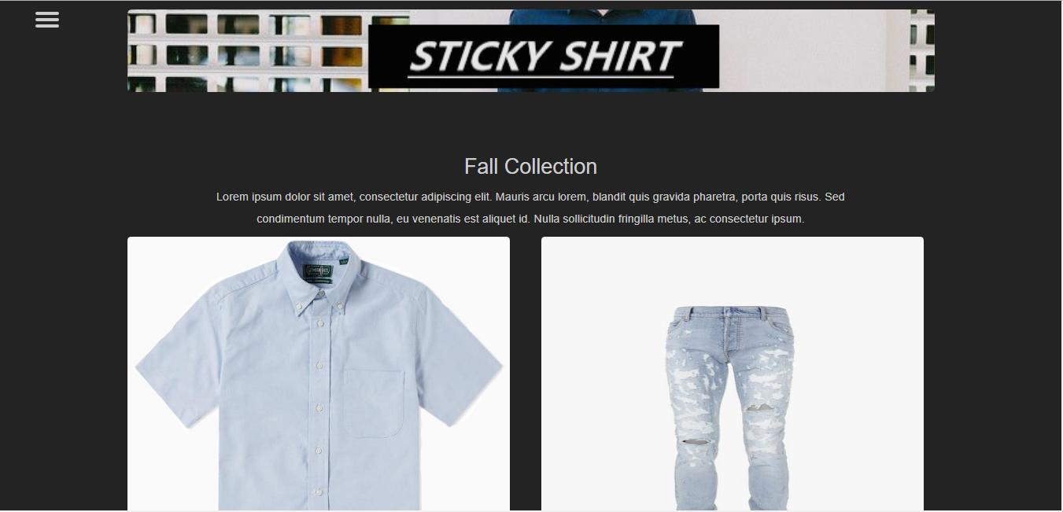
User Interface
Home page

Slide 19
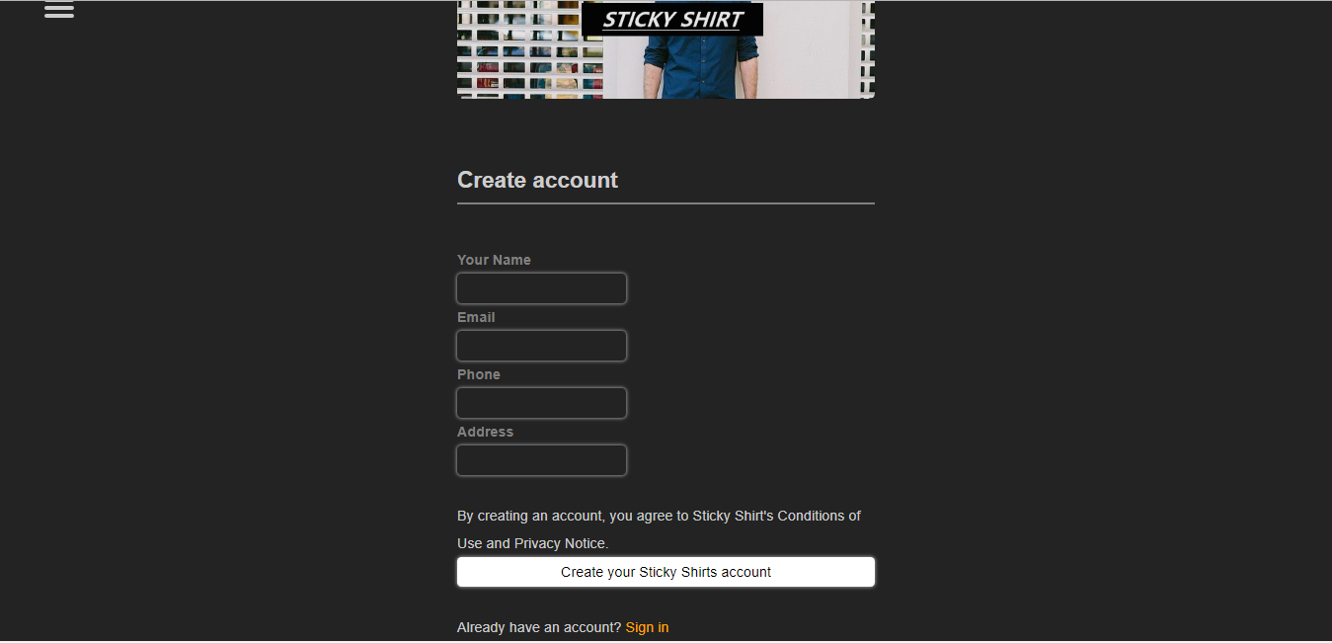
User Interface
Registration page

Slide 20
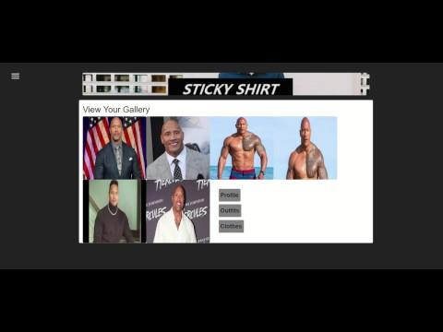
Video Demonstration

Slide 21
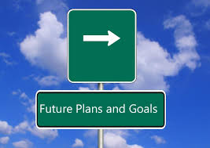
Plans Moving Forward
Moving forward we plan to incorporate the features which were not able to during this SDLC cycle. The most ambitious feature is the 3D view of the customer. This would require a lot of time to work on, but would make our application a unique one.

Slide 22
Conclusion
What was achieved with respect to the purpose?
We implemented the self-portrait feature for the customers. Customers are able to upload their own pictures into our database. Finally, we developed a clothing database and used it to show our collection on the website.
What still needs to be done?
The customers cannot see themselves in the clothes and compare different clothes. We did not implement the 3D view feature. Also, customers cannot compare different outfits.

Slide 23

Conclusion
Difficulties encountered
Developing a Sequence Diagram for Behavioral Modeling
Exploring the necessities which customers and users might need to enhance their shopping experience.
Notes:
We took the examples of many websites that we analyzed in the previous phase and figured how our system would handle the data and in turn, the user would have to feed the corresponding data to the system.
There are many competitors that we can use as models which we eventually resorted to because they are tested examples of successful website but when we tried to figure out the most user focused design it was truly an art rather than a science. It was helpful referring back to the design principles or content awareness, user experience and aesthetics when we were stuck.

Slide 24


